Slide 1

PUBLIC TRANSPORT IN MERIDA
GUILLERMO MEDINA
ROBERTO ARELLANO
ALEJANDRO NOVELO

Slide 2
PROBLEMATIC
The problem we intend to solve is that of the public transport system. As students, we depend on public transportation to come and go to school and our other daily activities, since the bus trip is much more accessible than private transportation. However, not only students depend on public transport but also workers and the elderly. On average, approximately 250 thousand people use public transport daily. That is approximately 26% of the current population of the city.

Slide 3
PROBLEMATIC
The problem lies in the fact that buses are not always reliable. Common problems are that buses do not leave on time, the bus does not stop to pick up or there was a traffic accident. All these problems equal the same effects; The user is late to his destination or must spend extra for private transport. Both cause discomfort, unforeseen expenses and delays.

Slide 4
DATA COLLECTION METHOD
For this project we will use observation and the whole team is or was a regular user of the Urban Transport System and this allows us an organic immersion with reliable results knowing the field as well.

Slide 5
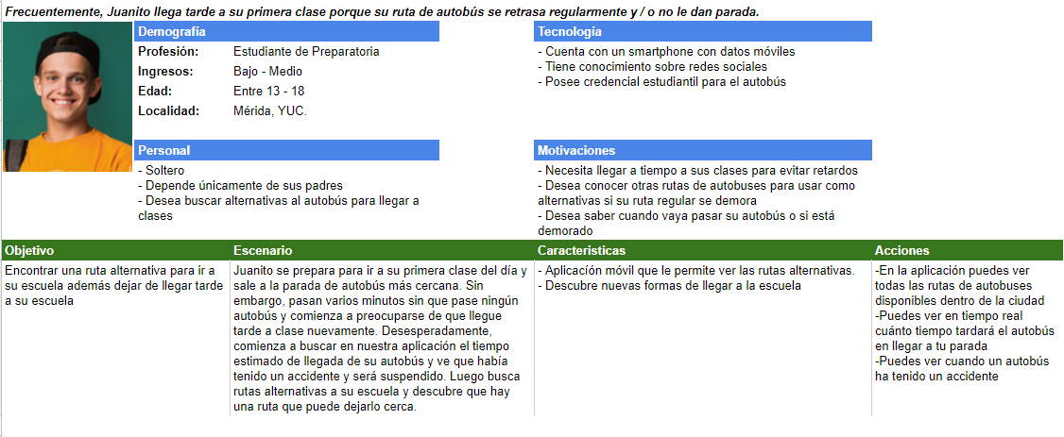
WE WILL BE USING PERSONAS TECHNIQUE. A PERSONA EXAMPLE.

Slide 6
TOOLS WE’VE USED SO FAR TO GATHER INFO
Google Docs.
Google Sheets.
Google Slides/Powerpoint.
Git.

Slide 7
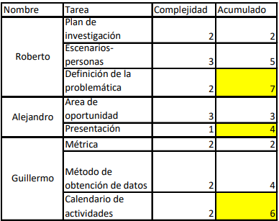
WORK METRICS
For our metric, we will count the complexity of each task, complexity being an arbitrary number between 1 and 5 with 1 for the simplest tasks and 5 for the most complex.

Slide 8
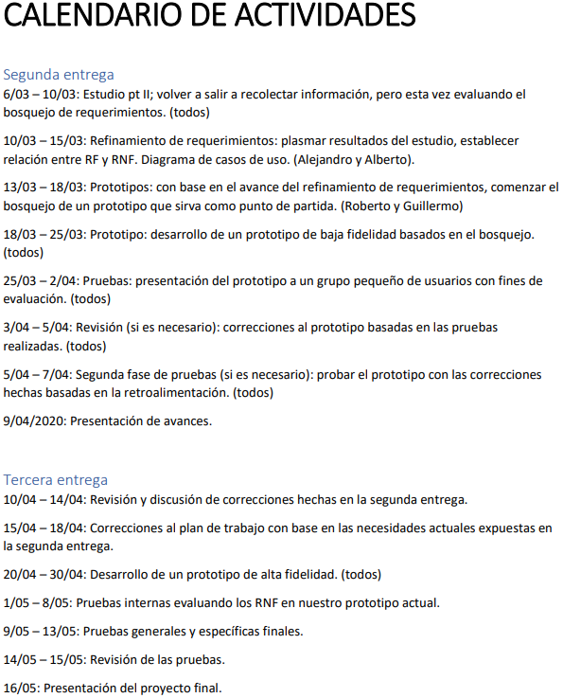
HERE WE PRESENT AN IDEALISTIC SCHEDULE FOR THE FUTURE ACTIVITIES

